Slide 1

Presented to: Dr. Mohammad Awde
© Templateswise.com
Machine Learning Project
Modeling the Linear Relationship between Sales and Advertising Dataset
Presented by:
Adel Alhajj Sleiman 5242
Rami Ajeeb 5633

Slide 2
Content
1- Project overview
2- Linear Regression
3- Simple Linear Regression (SLR)
4- Ordinary Least Square Method
5- Cost Function
6- The Problem Statement
7- Python Libraries
8- About The Dataset
9- Code

Slide 3
Project overview
In this project, We build a Linear Regression model to study the linear relationship between Sales and Advertising dataset for a dietary weight control product.

Slide 4
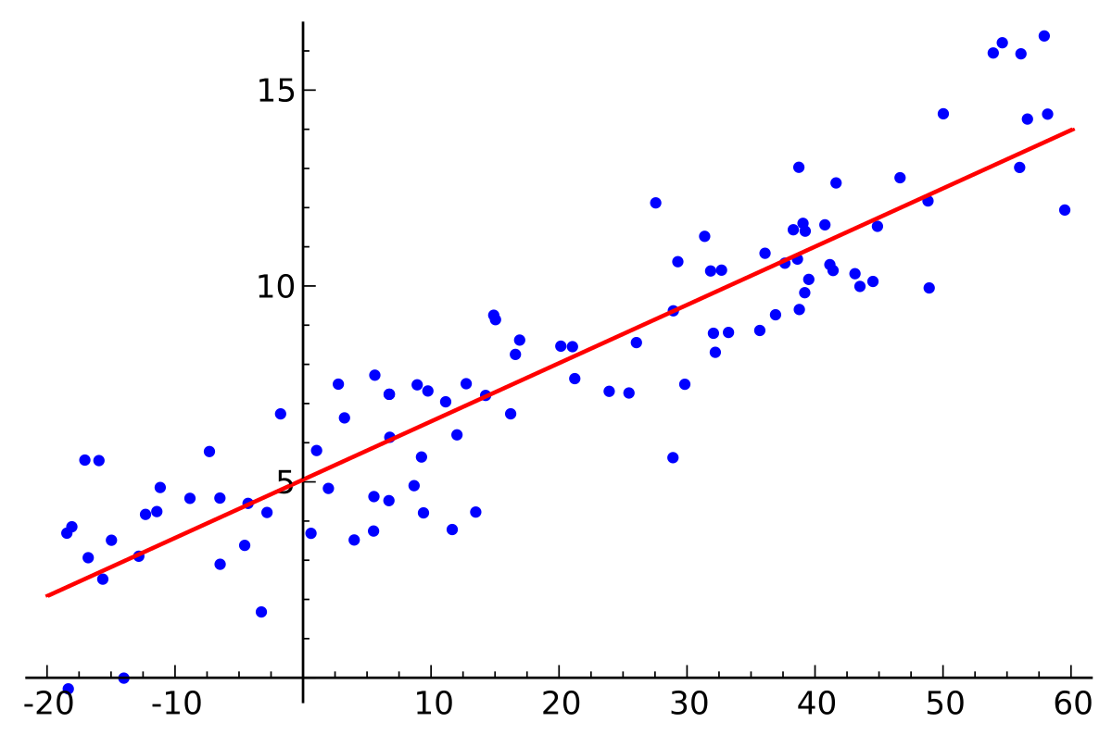
Linear Regression
Statistical Technique
Predict a Continuous Variable
Simple and Multiple
One Independent and One Dependent Variable

Slide 5
Simple Linear Regression (SLR)
It models the linear relationship between the independent and dependent variables
y = β0 + β1 * x
y and x are called independent and dependent variables respectively
β1 is the coefficient for independent variable and β0 is the constant term

Slide 6
Ordinary Least Square Method
the Sales and Advertising data are given by x and y respectively. We can draw a scatter plot between x and y which shows the relationship between them.
This line is called Regression line.
The regression line is the one which minimizes the error function. Such an error function is also called a Cost function.

Slide 7
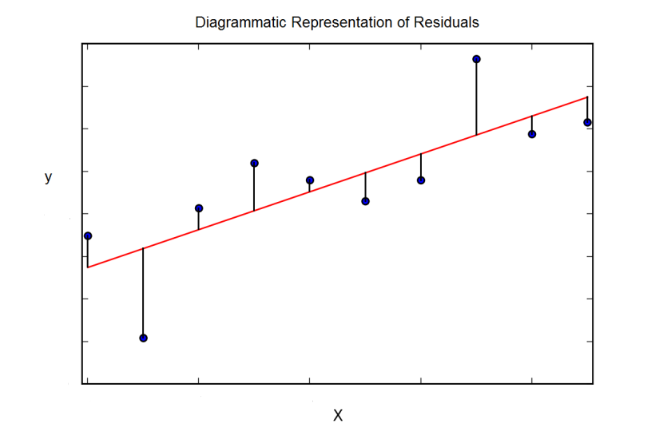
Cost Function
The vertical distance between each data point and the line is called the residual.
We will try to minimize the residuals by finding the line of best fit by minimizing the sum of the squares of the residuals.
di = yi - ŷI
D = Ʃ di**2

Slide 8
The Problem Statement
The aim of building a machine learning model is to solve a problem and to define a metric to measure model performance.
The problem is to model and investigate the linear relationship between Sales and Advertising dataset for a dietary weight control product.

Slide 9
Python Libraries
The basic Python libraries used in this project are:
• Numpy
• pandas
• Scikit-Learn
• Matplotlib

Slide 10
About The Dataset
This data set contains Sales and Advertising expenditures for a dietary weight control product. It contains monthly data for 36 months. The variables in this data set are Sales and Advertising.

Slide 11
Code
# Import necessary libraries
import numpy as np
import pandas as pd
import matplotlib.pyplot as plt
% matplotlib inline
# Import the data
url = "C:/project_datasets/SALES.txt"
df = pd.read_csv(url, sep='\t', header=None)

Slide 12
Code
# Exploratory data analysis
# View the dimensions of df
print(df.shape)
# View the top 5 rows of df
print(df.head())
0 1
0 12.0 15.0
1 20.5 16.0
2 21.0 18.0
3 15.5 27.0
4 15.3 21.0

Slide 13
Code
# Rename columns of df dataframe
df.columns = ['Sales', 'Advertising']
# View the top 5 rows of df with column names renamed
print(df.head())
Sales Advertising
0 12.0 15.0
1 20.5 16.0
2 21.0 18.0
3 15.5 27.0
4 15.3 21.0

Slide 14
Code
# View dataframe summary
print(df.info())
<class 'pandas.core.frame.DataFrame'>
RangeIndex: 36 entries, 0 to 35
Data columns (total 2 columns):
Sales 36 non-null float64
Advertising 36 non-null float64
dtypes: float64(2)
memory usage: 656.0 bytes
None

Slide 15
Code
# View descriptive statistics
print(df.describe())
Sales Advertising
count 36.000000 36.000000
mean 24.255556 28.527778
std 6.185118 18.777625
min 12.000000 1.000000
25% 20.300000 15.750000
50% 24.250000 23.000000
75% 28.600000 41.000000
max 36.500000 65.000000

Slide 16
Code
Independent or Input variable (X) = Feature variable = Predictor variable
Dependent or Output variable (y) = Target variable = Response variable
# Declare feature variable and target variable
X = df['Sales'].values
y = df['Advertising'].values
# Sales and Advertising data values are given by X and y respectively.
# Values attribute of pandas dataframe returns the numpy arrays.

Slide 17
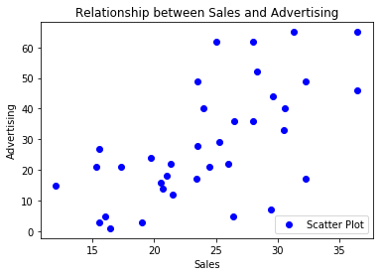
Code
# Plot scatter plot between X and y
plt.scatter(X, y, color = 'blue', label='Scatter Plot')
plt.title('Relationship between Sales and Advertising')
plt.xlabel('Sales')
plt.ylabel('Advertising')
plt.legend(loc=4)
plt.show()

Slide 18
Code
# Print the dimensions of X and y
print(X.shape)
print(y.shape)
# Reshape X and y
X = X.reshape(-1,1)
y = y.reshape(-1,1)
# Print the dimensions of X and y after reshaping
print(X.shape)
print(y.shape)
(36,)
(36,)
(36, 1)
(36, 1)

Slide 19
Code
# Split X and y into training and test data sets
from sklearn.model_selection import train_test_split
X_train,X_test,y_train,y_test = train_test_split(X, y, test_size=0.33, random_state=42)
# Print the dimensions of X_train,X_test,y_train,y_test
print(X_train.shape)
print(y_train.shape)
print(X_test.shape)
print(y_test.shape)
(24, 1)
(24, 1)
(12, 1)
(12, 1)

Slide 20
Code
# Fit the linear model
# Instantiate the linear regression object lm
from sklearn.linear_model import LinearRegression
lm = LinearRegression()
# Train the model using training data sets
lm.fit(X_train,y_train)
# Predict on the test data
y_pred=lm.predict(X_test)

Slide 21
Code
# Compute model slope and intercept
a = lm.coef_
b = lm.intercept_,
print("Estimated model slope, a:" , a)
print("Estimated model intercept, b:" , b)
# So, our fitted regression line is
# y = 1.60509347 * x - 11.16003616
# That is our linear model.
Estimated model slope, a: [[1.60509347]]
Estimated model intercept, b: (array([-11.16003616]),)

Slide 22
Code
# Predicting Advertising values
lm.predict(X)[0:5]
# Predicting Advertising values on first five Sales values.
# To make an individual prediction using the linear regression model.
print(str(lm.predict(24)))
array([[ 8.10108551],
[21.74438002],
[22.54692675],
[13.71891266],
[13.39789396]])
[[27.36220717]]

Slide 23
Code
Regression metrics for model performance:
Now, it is the time to evaluate model performance.
For regression problems, there are two ways to compute the model performance. They are RMSE (Root Mean Square Error) and R-Squared Value
RMSE:
It gives us how spread the residuals are, given by the standard deviation of the residuals. Lower values of RMSE indicate better fit of data.
# Calculate and print Root Mean Square Error(RMSE)
from sklearn.metrics import mean_squared_error
mse = mean_squared_error(y_test, y_pred)
rmse = np.sqrt(mse)
print("RMSE value: {:.4f}".format(rmse))
RMSE value: 11.2273

Slide 24
Code
R2 Score:
It indicates the percentage of variance that is explained by the model.
R2 Score = Explained Variation/Total Variation
The higher the R2 Score value, the better the model fits the data.
# Calculate and print r2_score
from sklearn.metrics import r2_score
print ("R2 Score value: {:.4f}".format(r2_score(y_test, y_pred)))
R2 Score value: 0.5789

Slide 25
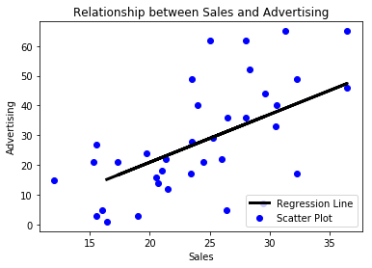
Code
Interpretation and Conclusion:
# Plot the Regression Line
plt.scatter(X, y, color = 'blue', label='Scatter Plot')
plt.plot(X_test, y_pred, color = 'black', linewidth=3, label = 'Regression Line')
plt.title('Relationship between Sales and Advertising')
plt.xlabel('Sales')
plt.ylabel('Advertising')
plt.legend(loc=4)
plt.show()

Slide 26
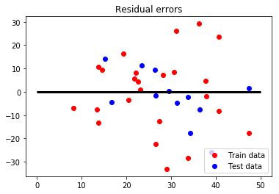
Code
Residual analysis:
we should validate our model by defining and examining residual plots.
The difference between the observed value of the dependent variable (y) and the predicted value (ŷi) is called the residual and is denoted by e. The scatter-plot of these residuals is called residual plot.
If we take a look at the generated ‘Residual errors’ plot, we can clearly see that the train data plot pattern is non-random. Same is the case with the test data plot pattern. So, it suggests a better-fit for a non-linear model.
# Plotting residual errors
plt.scatter(lm.predict(X_train), lm.predict(X_train) - y_train, color = 'red', label = 'Train data')
plt.scatter(lm.predict(X_test), lm.predict(X_test) - y_test, color = 'blue', label = 'Test data')
plt.hlines(xmin = 0, xmax = 50, y = 0, linewidth = 3)
plt.title('Residual errors')
plt.legend(loc = 4)
plt.show()

Slide 27
Code
# Checking for Overfitting or Underfitting the data
print("Training set score: {:.4f}".format(lm.score(X_train,y_train)))
print("Test set score: {:.4f}".format(lm.score(X_test,y_test)))
# Save model for future use
from sklearn.externals import joblib
joblib.dump(lm, 'lm_regressor.pkl')
# To load the model
# lm2=joblib.load('lm_regressor.pkl')
Training set score: 0.2861
Test set score: 0.5789
['lm_regressor.pkl']

Slide 28
References
i. Machine learning notes by Andrew Ng
ii. https://en.wikipedia.org/wiki/Linear_regression
iii.https://en.wikipedia.org/wiki/Simple_linear_regression
iv. https://en.wikipedia.org/wiki/Ordinary_least_squares
v. https://en.wikipedia.org/wiki/Root-mean-square_deviation
vi. https://en.wikipedia.org/wiki/Coefficient_of_determination
vii.https://www.statisticssolutions.com/assumptions-of-linear-regression/
viii.Python Data Science Handbook by Jake VanderPlas
ix. Hands-On Machine Learning with Scikit Learn and Tensorflow by Aurilien Geron
x. Introduction to Machine Learning with Python by Andreas C Muller and Sarah Guido

Slide 29
© Templateswise.com
Thank you for your time

